Slide 1
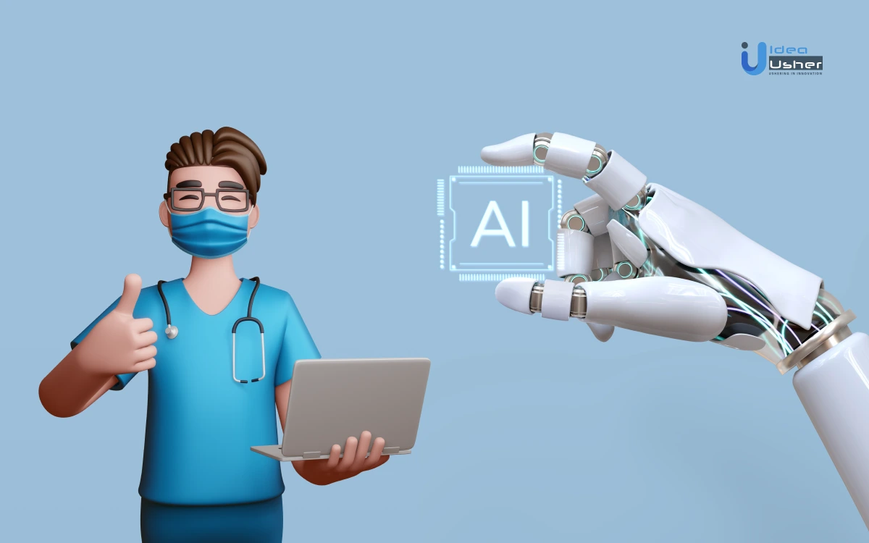
AI-Based Diagnosis & Symptom Checking System

Slide 2
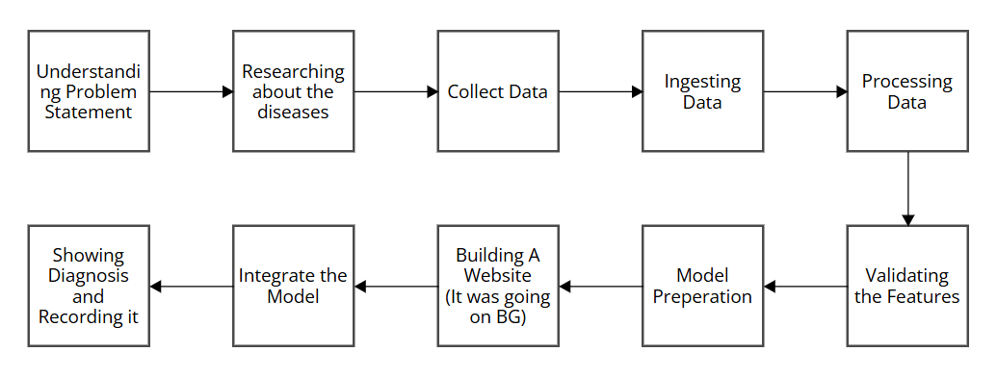
Project Flow

Slide 3
Problem Statement
AI for Diagnosis & Symptom Checking
Ways to solve the problem:
We can got through each domain and diagnose the disease.
We can use a common model for whole diseases.

Slide 4
Project Overview
What is it? An AI-powered mobile/web app for symptom checking.
How it works: Users input symptoms → AI analyzes data → Suggests potential conditions.
Goal: Improve accessibility to preliminary health assessments.

Slide 5
Key Features
User-Friendly Interface: Simple symptom input (text/voice).
AI-Powered Analysis: Uses machine learning models for accurate diagnosis.
Medical Database Integration: References verified sources (WHO, CDC, etc.).
Severity Assessment: Identifies whether a doctor consultation is needed.
Doctor Recommendations: Provides nearby healthcare provider details.
Health History Tracking: Saves past diagnoses for better insights.

Slide 6
Tech Stack
Frontend: HTML, CSS, React.js
Backend: Node.js
Database: MySQL
AI & ML: Python, Colab, Scikit-learn

Slide 7
Workflow Diagram
Step 1: User enters symptoms.
Step 2: AI model processes and compares with medical data.
Step 3: Possible conditions are displayed with severity levels.
Step 4: Users get recommendations for self-care or doctors.
Step 5: (If needed) Book a consultation.

Slide 8
AI Model & Data Processing
Data Collection: Medical datasets, verified symptom-disease relationships.
AI Model: Supervised learning with classification models.
Accuracy & Improvements: Continuous learning via feedback.

Slide 9
Benefits & Impact
For Users: Faster symptom analysis, better healthcare awareness.
For Healthcare Providers: Reduces unnecessary visits, prioritizes urgent cases.
For Society: Encourages preventive healthcare & reduces self-diagnosis errors.

Slide 10
Challenges & Solutions
Challenge: Data accuracy & medical validation.
Solution: Use certified datasets and expert validation.
Challenge: AI model bias & incorrect predictions.
Solution: Continuous training & real-time feedback loop.

Slide 11
Future Enhancements
Wearable Device Integration: Sync with smartwatches for real-time data.
Telemedicine Feature: Connect with doctors directly.
AI Chatbot: Personalized recommendations based on history.

Slide 12
Conclusion
Why this project matters: AI can revolutionize healthcare accessibility.

Slide 13
THANK YOU

